Slide 1

Customer Shopping Behavior Analysis
Uncovering Spending Patterns and Consumer Trends Across 3,900 Global Transactions
STRATEGIC INSIGHTS REPORT

Slide 2

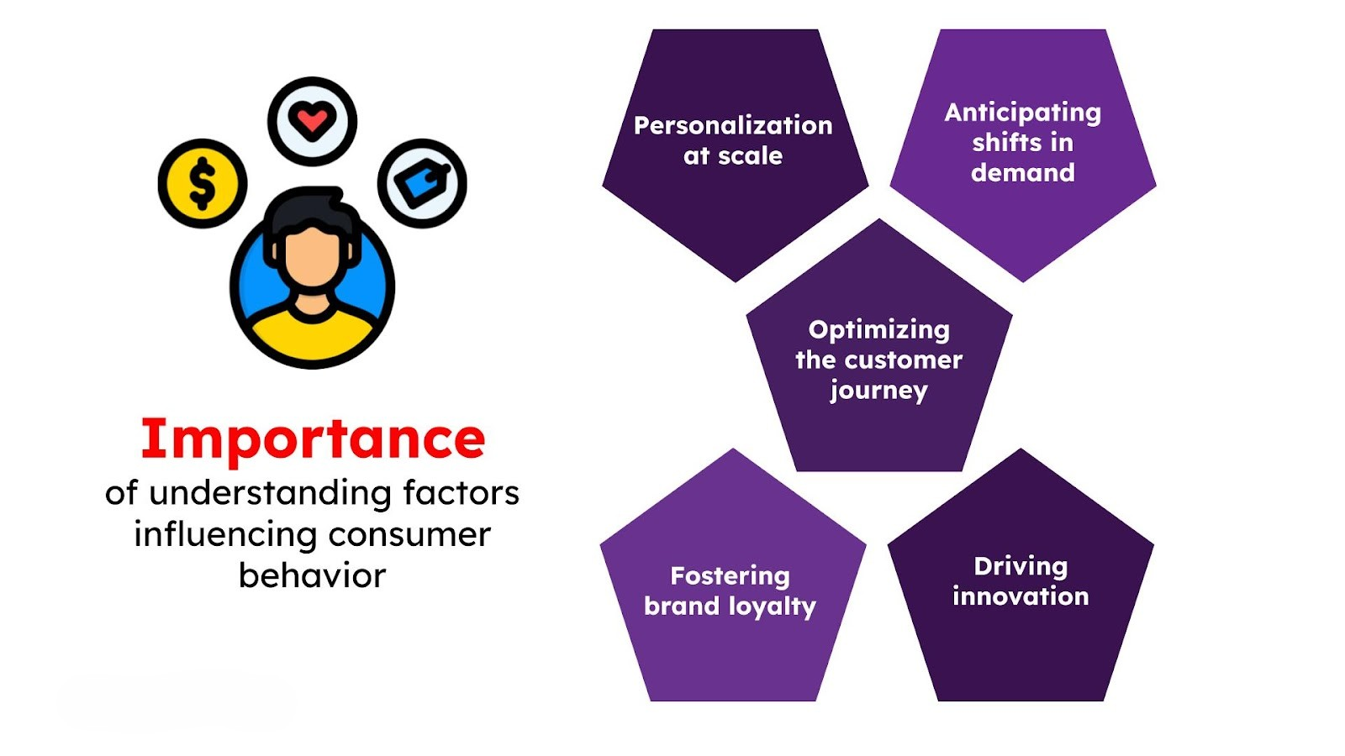

Executive Summary
Project Objective
This project leverages transactional data from 3,900 purchases to dissect customer behavior. We aim to guide high-level strategic decisions through data-driven insights.
Key Focus Areas
Spending patterns & seasonality
Customer segmentation & demographics
Subscription & promo efficacy

Slide 3






Data Inventory & Structure
3,900 Rows
Demographics
Behavioral
18 unique columns covering the full lifecycle of a customer transaction.
Granular data on Age, Gender, Location, and Subscription status.
Insights into Frequency, Ratings, Shipping types, and Payment methods.

Slide 4
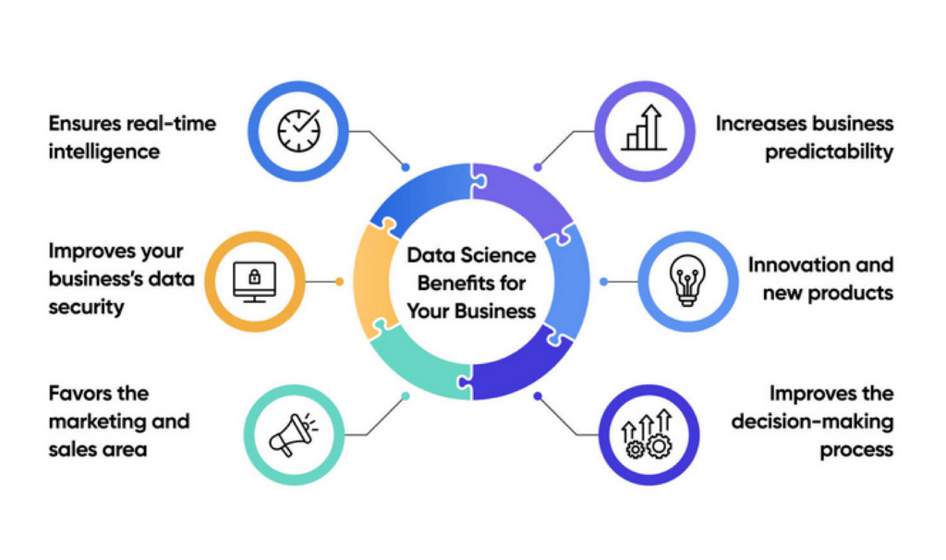
Data Preparation
Cleaning: Handled 37 missing review ratings via category-median imputation.
Engineering: Created age_group bins and purchase_frequency_days metrics.
Integration: Seamless ETL pipeline from Pandas to PostgreSQL for robust SQL analysis.

Slide 5
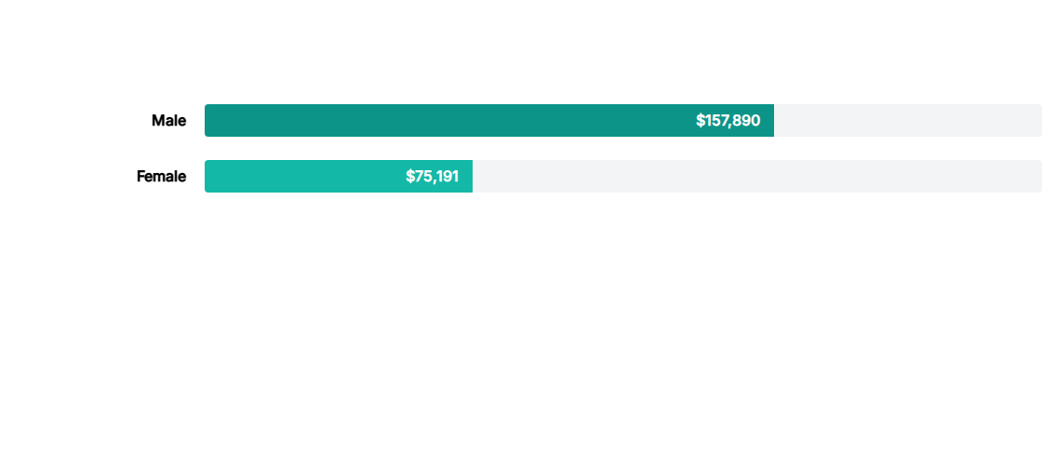

Revenue Distribution by Gender
Observation: Male customers contribute over 67% of total revenue. Targeted marketing towards high-spending female demographics represents a significant growth opportunity.

Slide 6
Top 5 Products by Rating
Rank | Item Purchase | Category | Avg. rating
1 | Gloves | Accessories | 3.86
2 | Sandals | Footwear | 3.86
3 | Boots | Footwear | 3.82
4 | Hat | Accessories | 3.80
5 | Skirt | Clothing | 3.78

Slide 7
Subscription Penetration
27%
73%
Subscribed
Non-Subscribers
1,053 Customers
2,847 Customers
Interestingly, the average spend is nearly identical between groups ($59.49 vs $59.87), suggesting subscriptions currently impact loyalty rather than basket size.

Slide 8
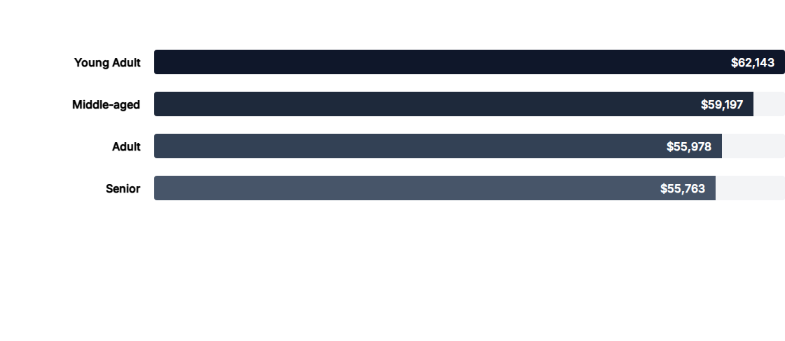
Revenue Contribution by Age Group
The "Young Adult" segment is the primary revenue driver, but the variance across age groups is narrow, indicating a highly versatile product appeal.

Slide 9
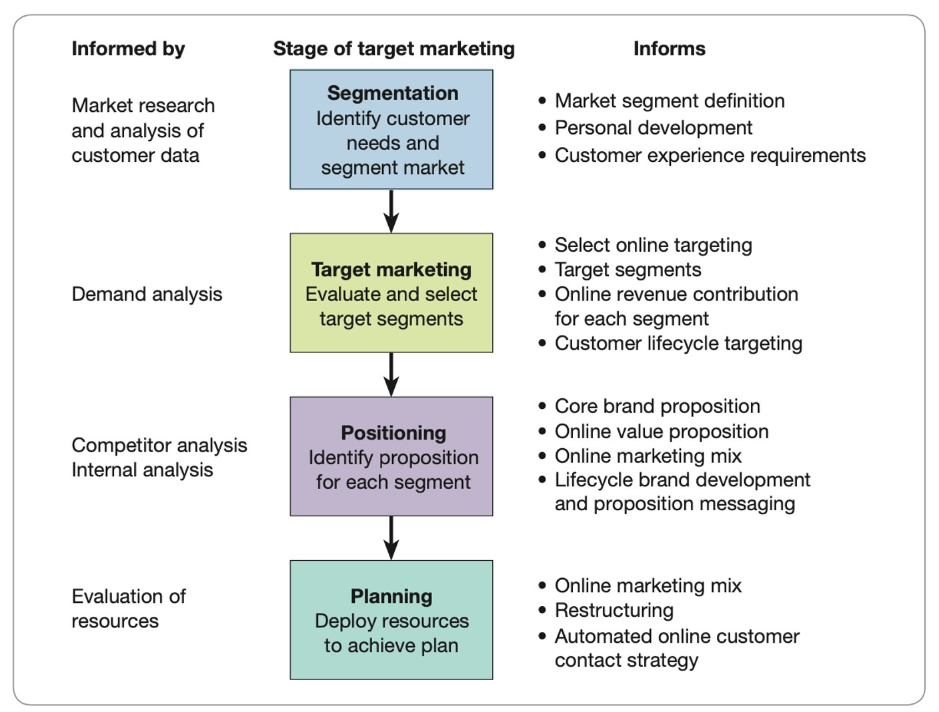
Behavioral Segmentation
Loyal (3,116): Customers with a deep history of consistent engagement.
Returning (701): Buyers who have re-engaged after an initial purchase.
New (83): The smallest segment, indicating a need for improved acquisition strategies.

Slide 10


Insights Dashboard
Our Power BI integration provides real-time visibility into:
Key KPI Metrics: Avg. Purchase: $59.76 Avg. Rating: 3.75
Visualizing the data revealed that Clothing and Accessories dominate total sales, while Express Shipping users tend to spend marginally more per transaction ($60.48 vs $58.46).

Slide 11
Business Recommendations
Boost Subscriptions: Promote exclusive benefits to the 73% non-subscriber base.
Margin Control: Re-evaluate discount policies on products like Hats (50% discount rate).
Loyalty Programs: Focus on moving "Returning" buyers into the "Loyal" tier.
Targeted Ads: Focus digital spend on the high-revenue Young Adult group.

Slide 12
Questions?
Thank you for your time. For detailed SQL queries or the Python cleaning scripts, please refer to the project repository.
DATA ANALYSIS | Q2 REPORT | RETAIL STRATEGY

